Slide 1

Capstone project – Segment 2
Cheryl berger • Lucien Roberts • martha richardson

Slide 2
Agenda
Topic Selection
Data Exploration
Objectives
Machine Learning Model
Data Pre-Processing
Feature Selection & Engineering
Model Assessment & Selection (Limitations & Benefits)
Database Selection & ERD
Database Interface Description
Illustrations
Join using dbase language
Connection String (SQL)
Analysis
Initial Outcomes – Linear Regression
Model Outcome – Random Forest Classification
Conclusions (Segment 4)
Discussion (Segment 4)
Additional Machine Learning Models

Slide 3


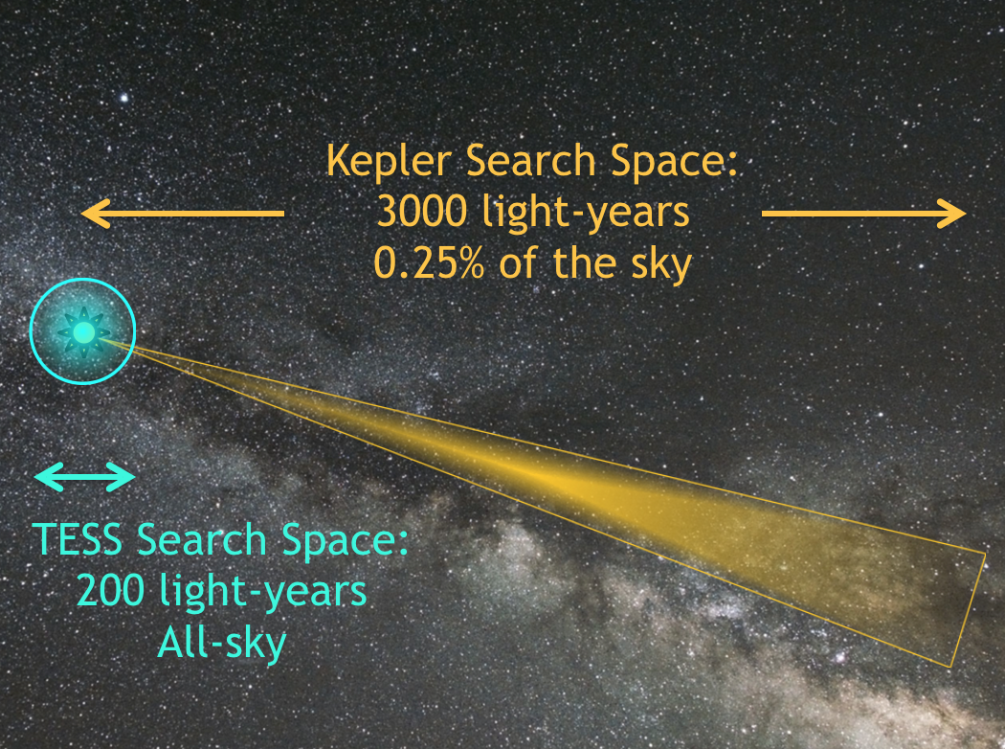



Topics considered
Some datasets were too small
Some datasets were too big
We found one that was just right!

Slide 4


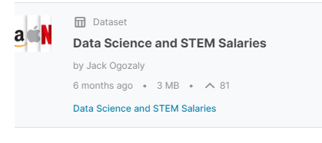

Our project
Kaggle Data Science and STEM Salaries Dataset

Slide 5
Why choose this dataset?
It is extremely relevant to all of us
The dataset pretty large, needs some pre-processing, but is not so big that we have trouble storing and sharing it
There are several columns in the data we can target for different types of analysis

Slide 6
Description of dataset
29 Columns and 62,642 rows
Data Science and STEM Salaries from June 7, 2017 to August 17, 2021
https://www.kaggle.com/datasets/jackogozaly/data-science-and-stem-salaries
Demographics – Gender, race, location, education level
Salary Details – Base and total annual salaries, bonus &/or stock option values
Employment - Company name, years of experience and years at employer

Slide 7
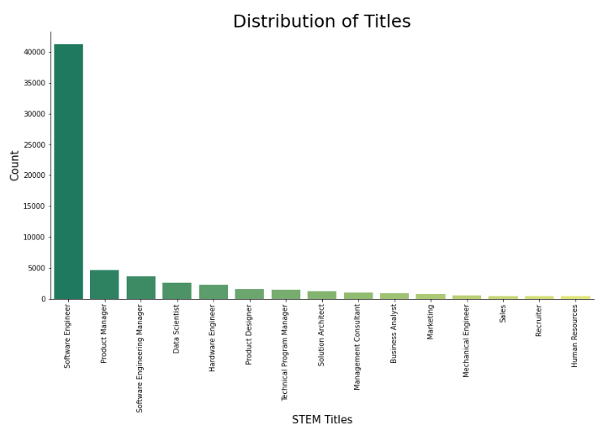
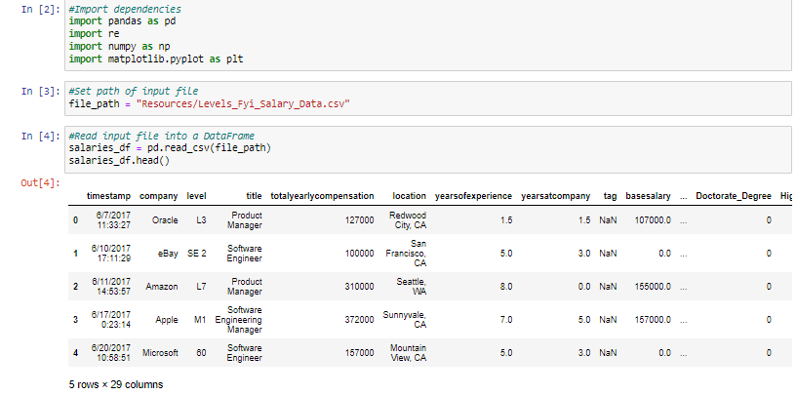
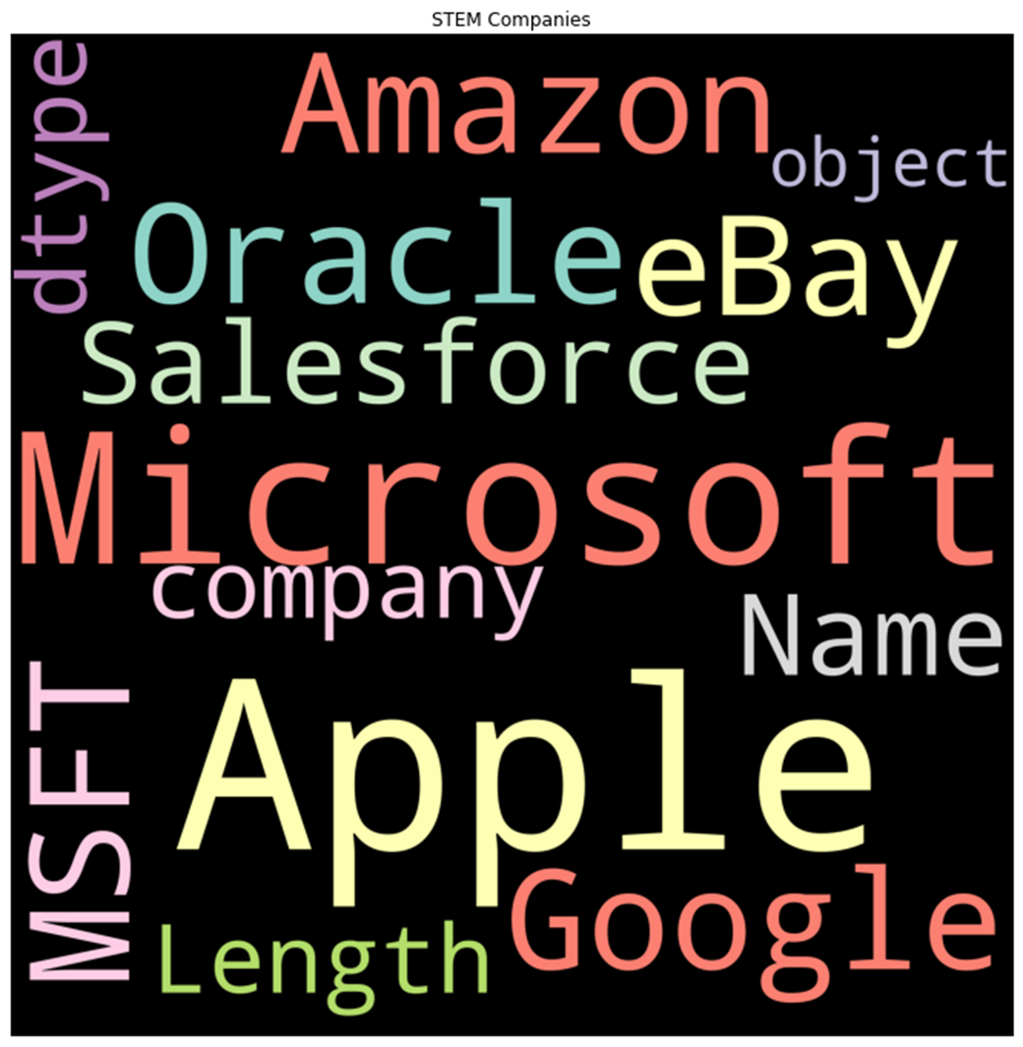
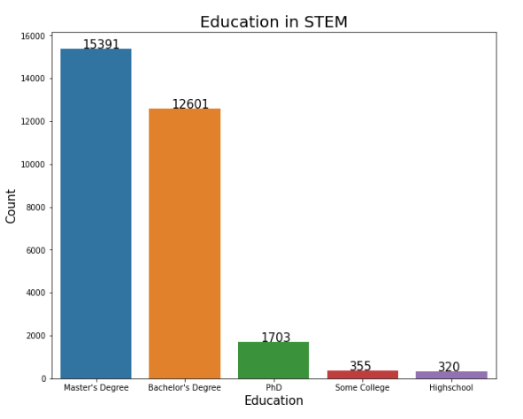
A “SnEAK PEAK” AT THE DATA

Slide 8
OBJECTIVES OF OUR PROJECT
Discover what features and model make the best predictions for salaries of STEM Professionals and Data Scientists
Explore the data and visualize contents, perform data cleaning, engineer the features, and pre-process the dataset for machine learning
Identify the best predictive model and select the user input features.
Develop the ERD and connect a SQL Database to the model
Present our results via an interactive table similar to the UFO or Bellybutton projects

Slide 9
Data Exploration
Explore the data for predictive features
Note the continuous vs categorical values
Evaluate the distribution of the data for various features
Identify Opportunities for data cleaning
Capstone Project - Tableau Vizs

Slide 10
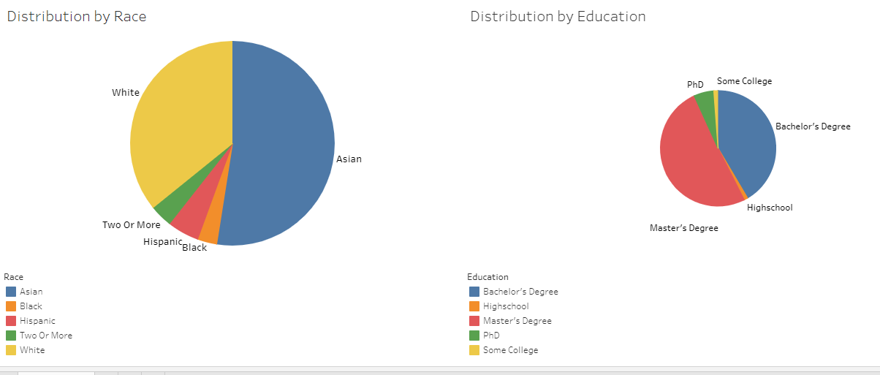
Distribution of DEMOGRAPHIC FEATURES

Slide 11
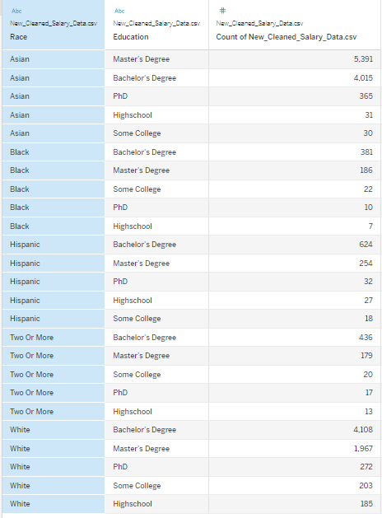
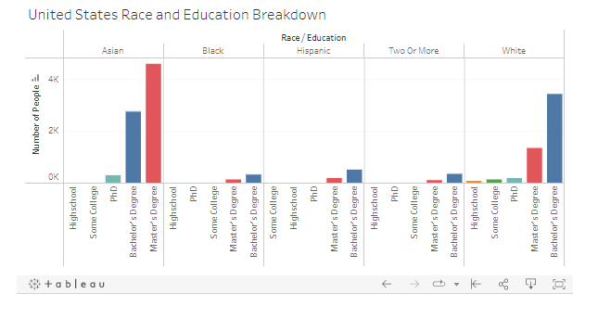
DISTRIBUTION OF EDUCATION BY RACE in THE US

Slide 12
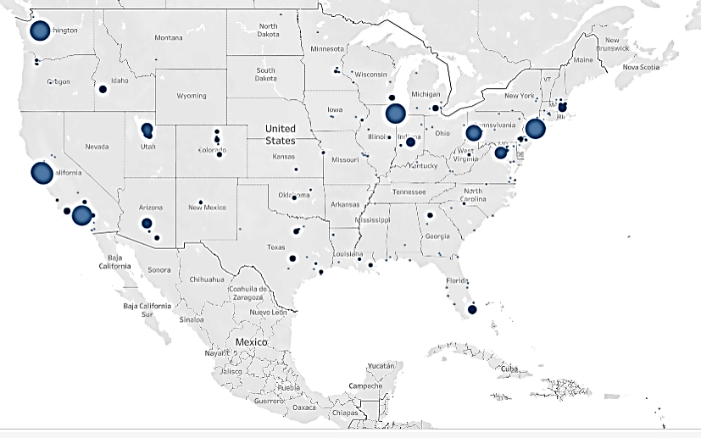
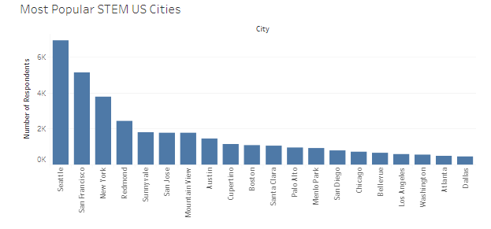
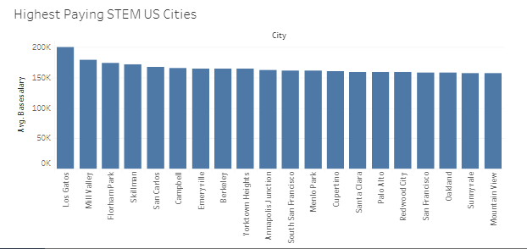
LOCATION, LOCATION, LOCATION!!
https://public.tableau.com/app/profile/lucien.roberts/viz/Capstone-2_16503935278710/US

Slide 13
Proposed machine learning model
We plan to deploy a machine learning model that can be used to predict salaries for data scientists and STEM professionals.
Linear regression is the best model to choose with a continuous variable like salary.
With our cleaned and pre-processed data, we will divide the data into training and testing sets and then train and test our model
The salary prediction by years of service example in Module 17.2.3 was the starting point for our coding
We will explore which features are the best predictors, and possibly look into other Scikit-learn linear regression models

Slide 14
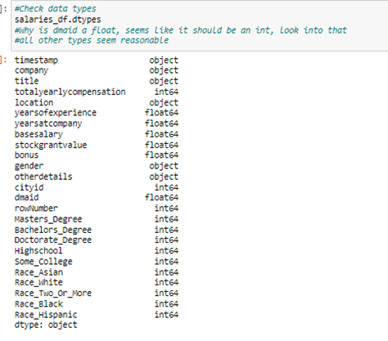
DATA CLEANING STEPS – RounD 1
Reduced noisy data:
Checking for usable DataTypes
Transform the location column
Performing Outliers Analysis
Other Data Cleaning
Drop 29 duplicate rows, 0 duplicate columns
Drop unwanted columns
Remove null values
gender 19540
otherdetails 22505
Drop 5 rows where company is NaN missing rows (data now has 62,637 rows)
Convert timestamp field from object to datetime
Clean-up erroneous data values in location and gender columns
The total number of rows with data in the education columns is 30472 out of 62637 rows
The total number of rows with data in the race columns is 22426 out of 62637 row
Identified and corrected additional typographical and formatting errors in the data

Slide 15
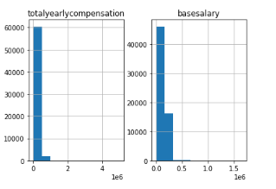
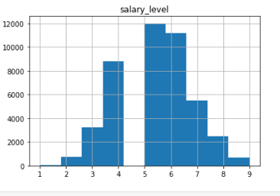
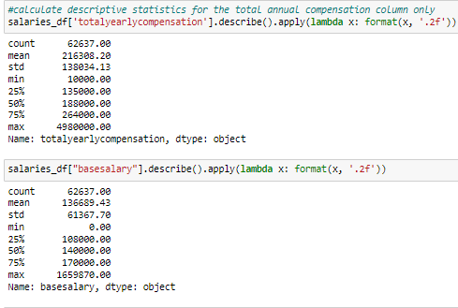
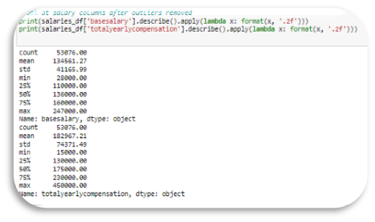
Noisy & UNWANTED DATA
Total & Base Salary BEFORE Cleaning
Salary Levels AFTER Cleaning

Slide 16
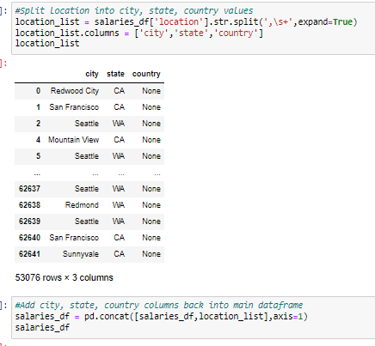
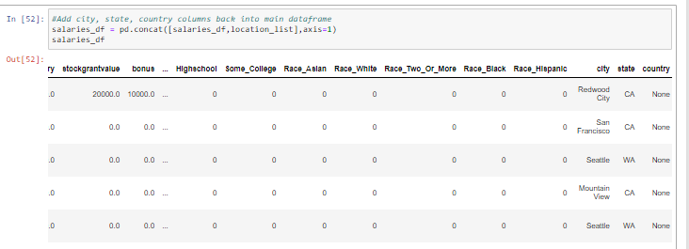
SPLIT the LOCATION COLUMN
The feature “location” is an object containing a string list of city and state
This feature will be split and added back to the data for review of regional contributions to the output

Slide 17
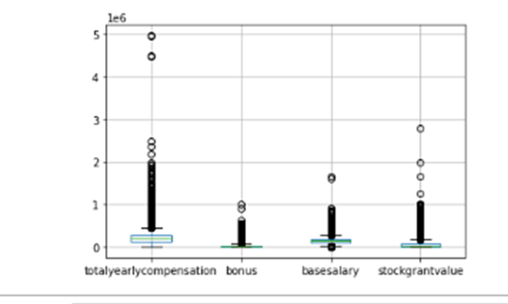
ANALYZE DATA FOR OUTLIERS
Drop Outliers from Dataset,
53,076 rows × 25 columns
Write the clean data to file
Resources/Cleaned_Salary_Data.csv
Column Name | # Outliers | % of Outliers
Total Yearly Compensation | 3133 | 5.00
Base Salary | 2155 | 3.44
Stock Grant Value | 4683 | 7.48
Bonus | 2604 | 4.16

Slide 18
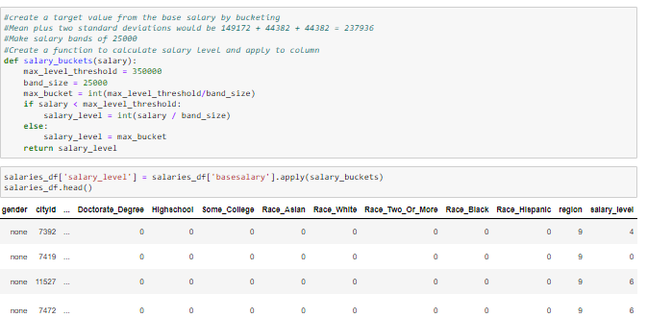
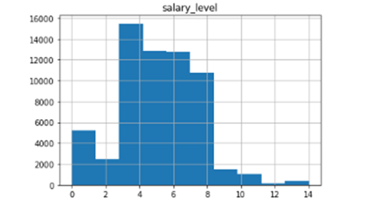
FEATURE ENGINEERING – Salary level
For rows where basesalary = 0, set equal to totalyearlycompensation
Create a target value from the base salary by bucketing
Mean plus two std dev. would be 149,172 + 44,382 + 44,382 = 237,936
#Make salary bands of 25,000 for a total of 15 salary levels

Slide 19
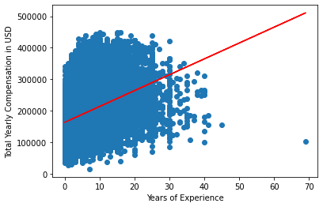
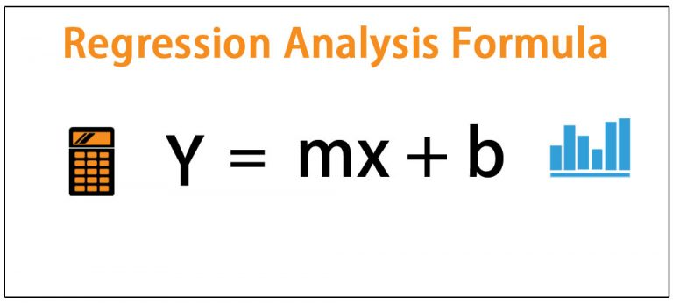
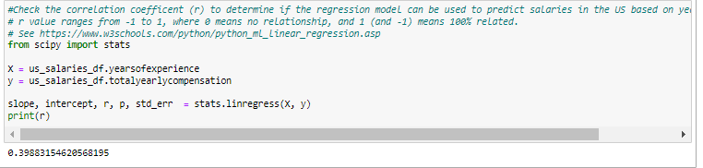
Linear RegRession
Resources/US_Salary_Cleaned.csv
The slope = [5040.09]
The y-intercept = 163190.93
r = 0.398
r = 0.40 (r²=0.18) is a weak correlation, this model could use improvement.
Cleaning_Data.ipynb
See https://www.w3schools.com/python/python_ml_linear_regression.asp

Slide 20
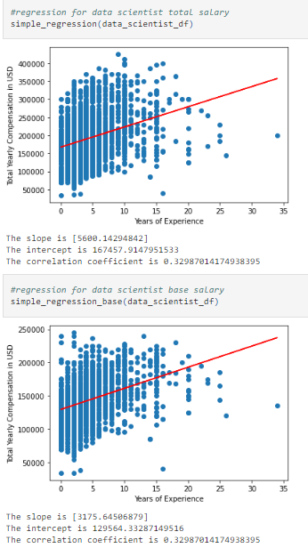
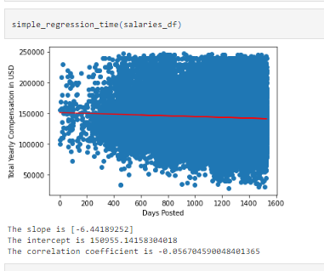
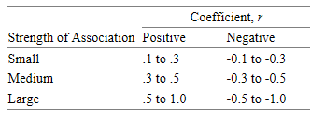
Other Regression FEATURES EXPLORED
Job Title
Date Entered
Linear Regression models have a low r and a medium strength of association
We seek r= 0.5 or higher

Slide 21
SUPERVISED LEARNING – RANDOM FOREST CLASSIFICATION
CLASSIFICATION OF THE DATA
DROPPING OUTPUT COLUMS
ONE HOT ENCODING
SCALE USING STANDARD SCALER
SPLIT INTO TEST/TRAINING DATASETS
Training Data Shape (46977 rows, 38 columns)
Test Data (15660 rows, 38 columns)
Preprocessing for Other Models.ipynb

Slide 22

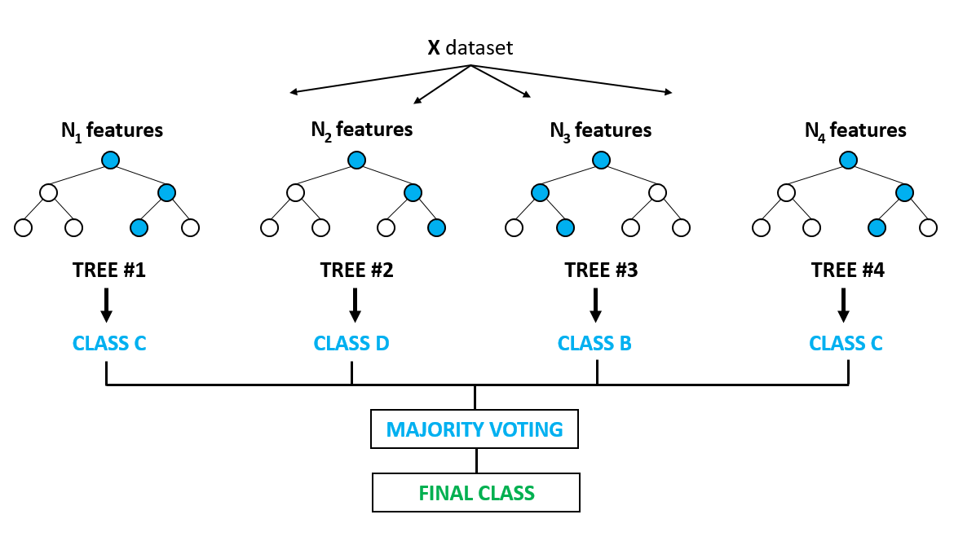
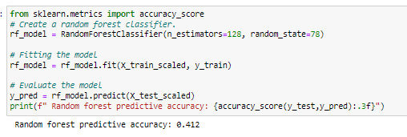
RANDOM FOREST MODEL (RFM) – ALL FEATURES

Slide 23
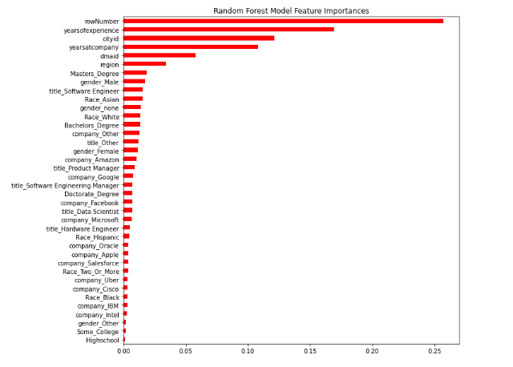
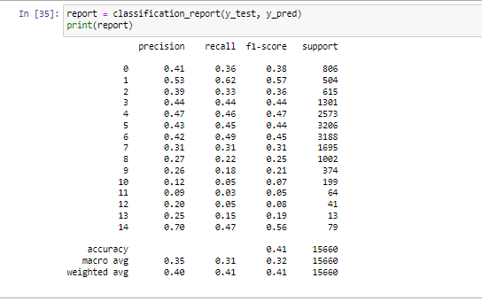
OUTCOMES & IMPORTANCES – RFM ALL FEATURES
Import Dependencies
from sklearn.metrics import accuracy_score, confusion_matrix, classification_report
Predictive Accuracy = 0.41
F1 Score = 0.41

Slide 24
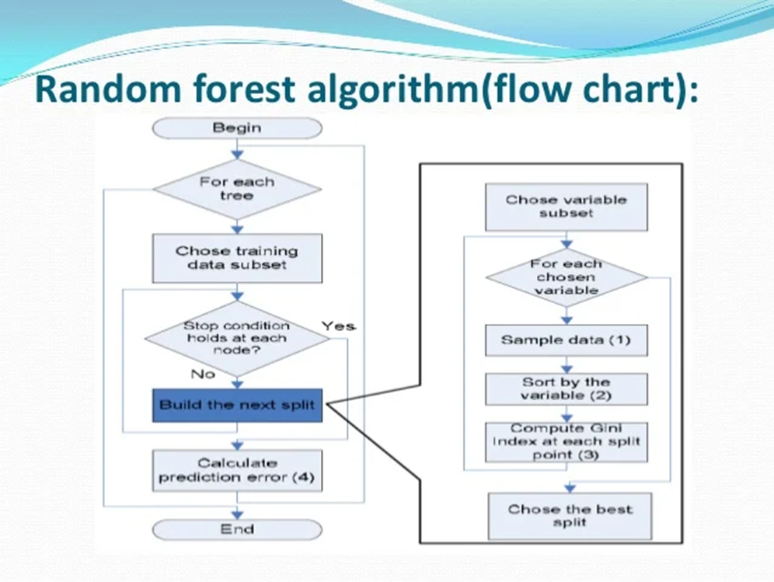
FINAL MODEL SELECTION
CLASSIFICATION OF THE DATA
DROP OUTPUT COLUMS
PERFORM ONE HOT ENCODING
SCALE USING STANDARD SCALER
SPLIT INTO TEST/TRAINING DATASETS
Training Data Shape (46977 rows, 38 columns)
Test Data (15660 rows, 38 columns)
Final_model_random_forests.ipynb

Slide 25
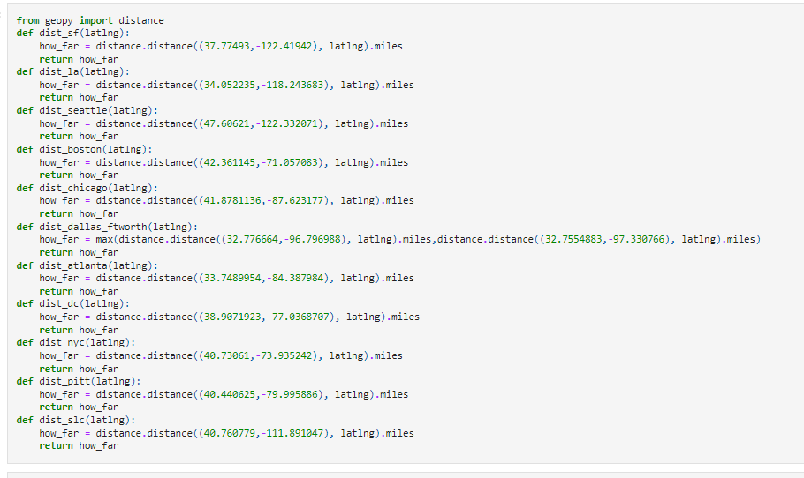
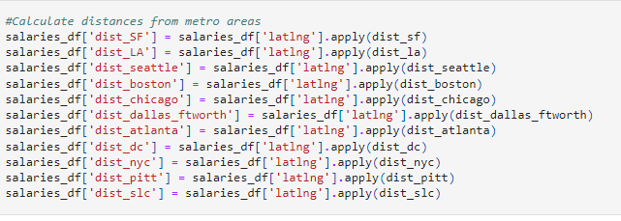
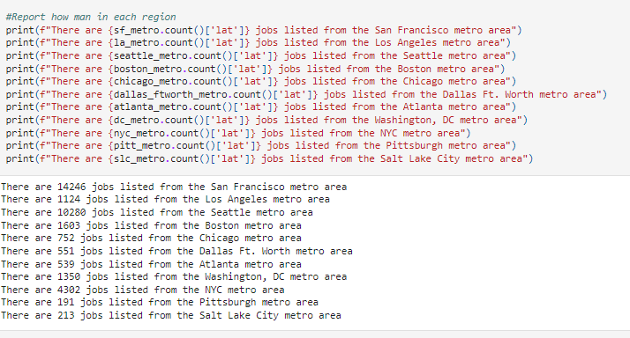
FEATURE ENGINEERING - REGION
Look at each metro and calculate the distances from the location to the downtown and include participants within 30-50 miles maybe?
Start by retrieving long,lat for each city
Use an openweathermap API call to get the long and lat for each city and state combinations
Create a loc group for each of the top 9 regions
For each region, calculate a field that is distance from the central metro
Use this distance to decide who to include in that region, be consistent if it makes sense to
Use this distance to decide who to include in that region, be consistent
Avoid overlap any of the identified regions
Anyone not in these top 9 groups is classified into group 10.

Slide 26
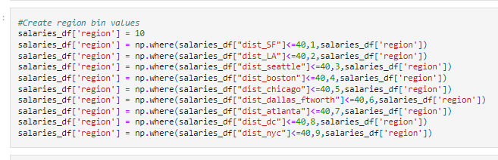
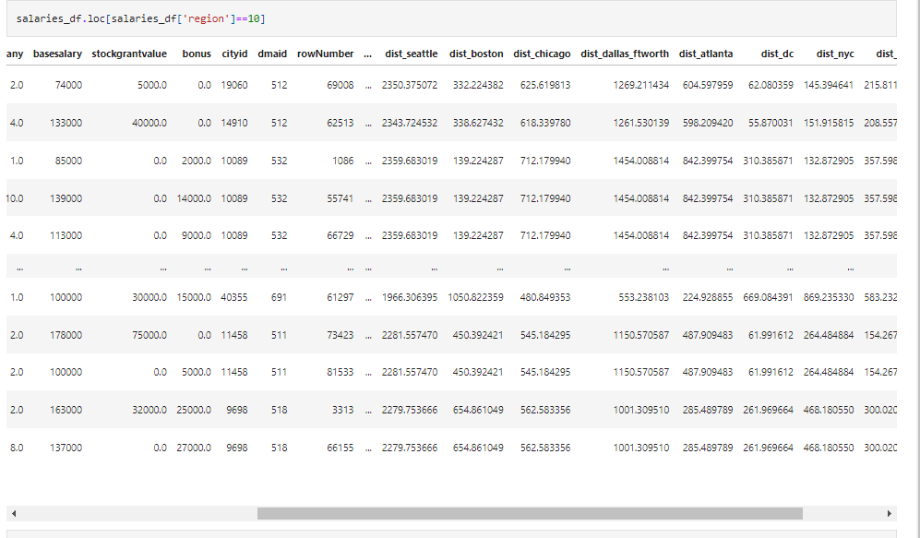
FEATURE ENGINEERING – BinNING REGION
Create the Region Bins by establishing distances of <=40miles from the metro center.
Allow Region 10 to include all other locations
A total of 10 regions are generated
Region 10 contains 9976 rows

Slide 27
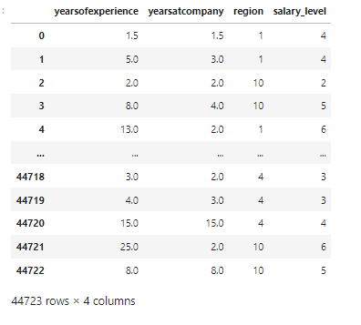
FINAL DATA PREpARATION
Load the Preprocessed data
Resources/US_Salary_Preprocessed_new_regions.csv (44723 rows × 29 columns)
Drop features that don't contribute much to model: company, job title, gender, race, and education, 'dmaid','cityid','rowNumber','timestamp
Final DataFrame (salaries_df) contains Years of Experience, Years at company, Region and Salary Level
The dataset now has 44723 rows but only 4 columns
DONT FORGET:
# Remove output from features data
y = salaries_df.salary_level
X = salaries_df.drop(columns=['salary_level'])

Slide 28
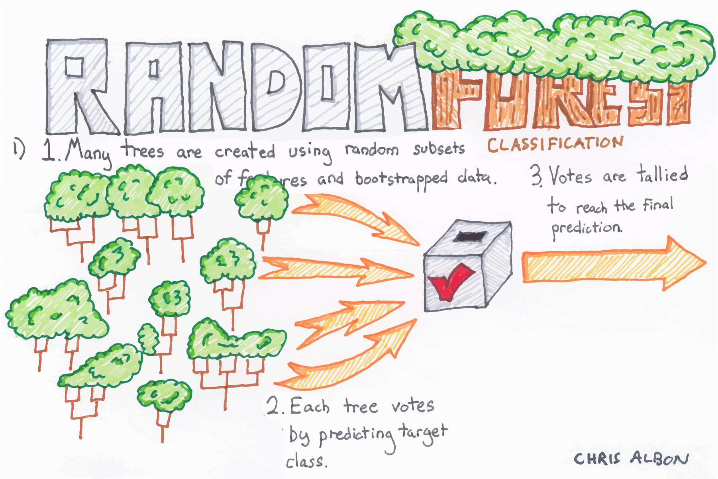
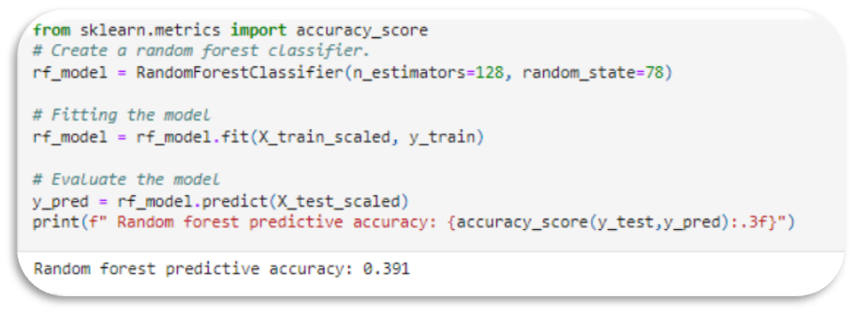
RANDOM FOREST MODEL – 3 FEATURES
Resources/US_Salary_Preprocessed_new_regions.csv"
Training Data Shape = 33,542 rows, 3 columns
Test Data Shape = 11,181 rows, 3 columns

Slide 29
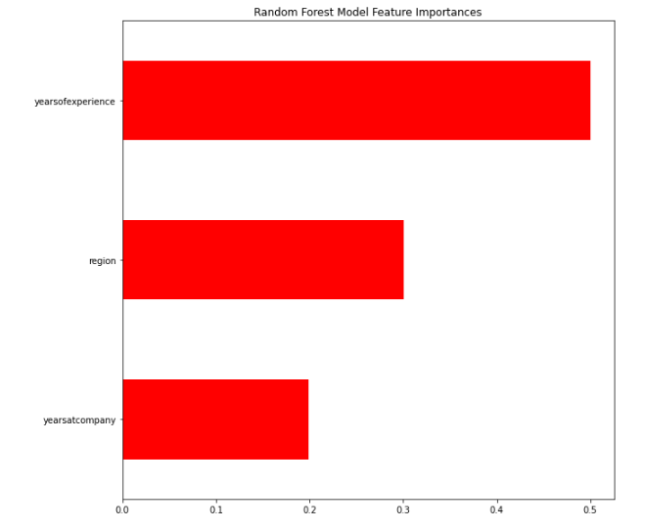
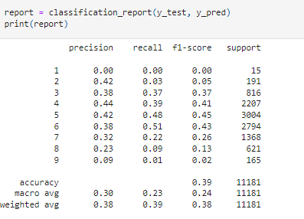
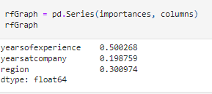
OUTCOMES & IMPORTANCES – RFM 3 FEATURES
Predictive Accuracy = 0.391
F1 Score = 0.39

Slide 30

MACHINE LEARNING MODEL SELECTION
BENEFITS
Regressions models are constrained to continuous variables while categorical variables can be used with Ensemble Learning
Classification Models allows for the use of several features to optimize output
Classification models provide a superior method for working with missing data
Reduced risk of overfitting: Decision trees run the risk of overfitting as they tend to tightly fit all the samples within training data.
DRAWBACKS
Regression models constrained to continuous variables and require considerable cleaning
For data including categorical variables with different number of levels, random forests are biased in favor of those attributes with more levels. Therefore, the variable importance scores from random forest are not reliable for this type of data.
When the data contain groups of correlated features of similar relevance for the output, then smaller groups are favored over larger groups

Slide 31
DataBase SELECTIOn & ERD

Slide 32
Database
We created the schema and imported the original datafile into PostgreSQL with the following alterations:
We removed the other details column from the dataset to import into the database. It contained mostly ancillary and unrelated data, making it completely useless for our machine learning project
The headers for the timestamp, level, and location needed to be changed as they were reserved names in PostGres.
The rowNumber value was used as the primary key

Slide 33
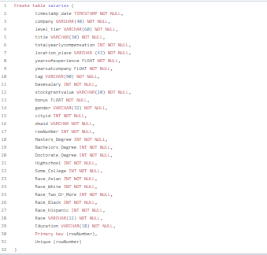
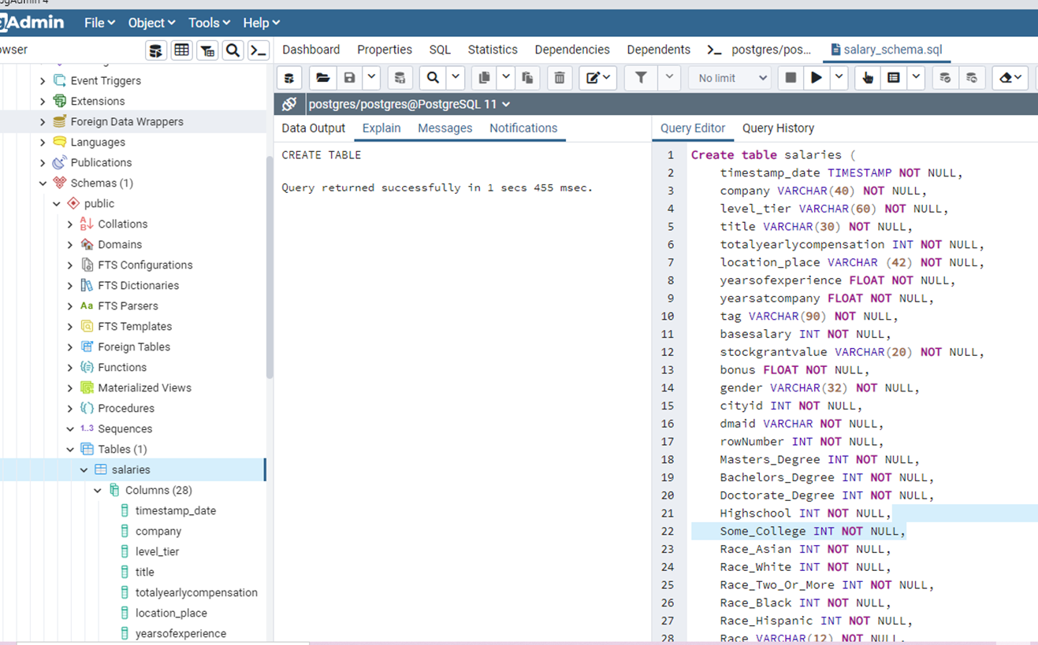
SCHEMA
https://github.com/mgsrichard/Capstone-Project/blob/main/salary_schema.sql

Slide 34
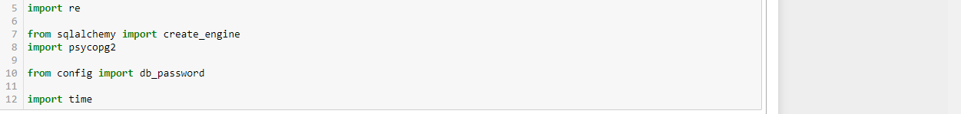
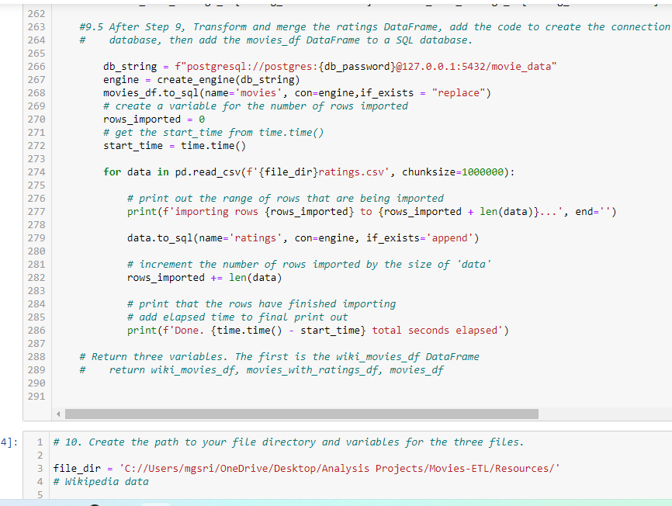
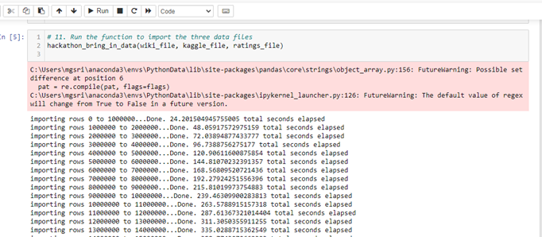
Connecting to the DataBase
Import dependencies
Create Config file (app.py)
Transform and Merge the DataFrame with the DataBase
Write the function to import the datafile

Slide 35

Initial DATABASE COMMITT
https://github.com/mgsrichard/Capstone-Project/blob/main/rf_model_pkl

Slide 36
ConCLUSIONS
Random Forest Model
Predictive Accuracy is 40% , F1 Score is 0.39
Key Features = Years of Experience, Years at company, Region

Slide 37
Discussion

Slide 38
UNSUPERVISED LEARNING
Grouping by location
API Call for Lat/Lng to improve clustering for Kmeans analysis

Slide 39

QUESTIONS?

